Slide 1
Lesson 3: Robot Parts and Writing Robot Code
Fe Maidens Programming 2017-2018
Welcome back!
Notes:
Make sure everyone is on their own computer because they will need to go on the API and explore it themselves
http://first.wpi.edu/FRC/roborio/release/docs/java/

Slide 2
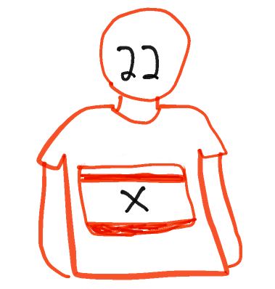
Review
Last week, we learned about variables, methods ,and classes. Does anyone have any questions about making and using these?

Slide 3
How do we put everything we learned together?
Today, we’ll be learning about how to write code for the robot specifically. By the end of this lesson, you’ll be able to write code that makes the robot drive and makes a piston extend.

Slide 4

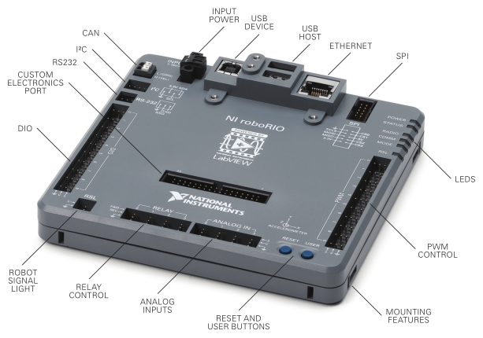
RoboRIO
The roborio is the computer onboard every FRC robot. It’s what stores the code and executes commands. In order to use the RoboRIO, code must be loaded onto it by “building” it.
Think about it as the human BRAIN!
Notes:
Make sure to clarify that the roboRIO isn’t a part that we program. It’s just the part that we use to run the code (we don’t control it)

Slide 5
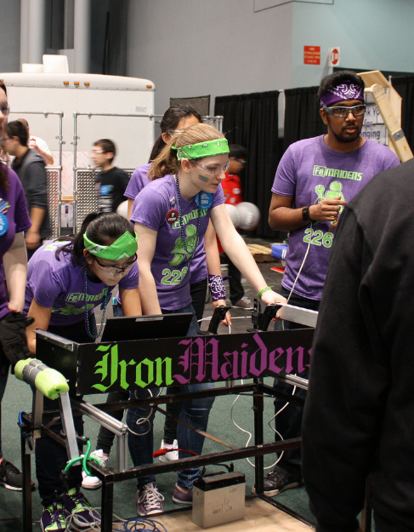
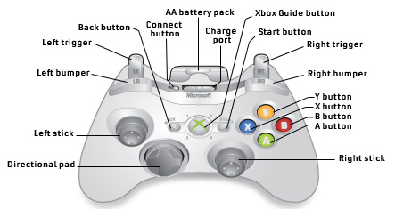
Joysticks
Joysticks are the main way that our drivers control the robot. On the FeMaidens, we usually use XBox style joysticks, but any form of input can be used, from boards of buttons to motion control via a Kinect.
Notes:
Mention that each button corresponds with a specific number

Slide 6
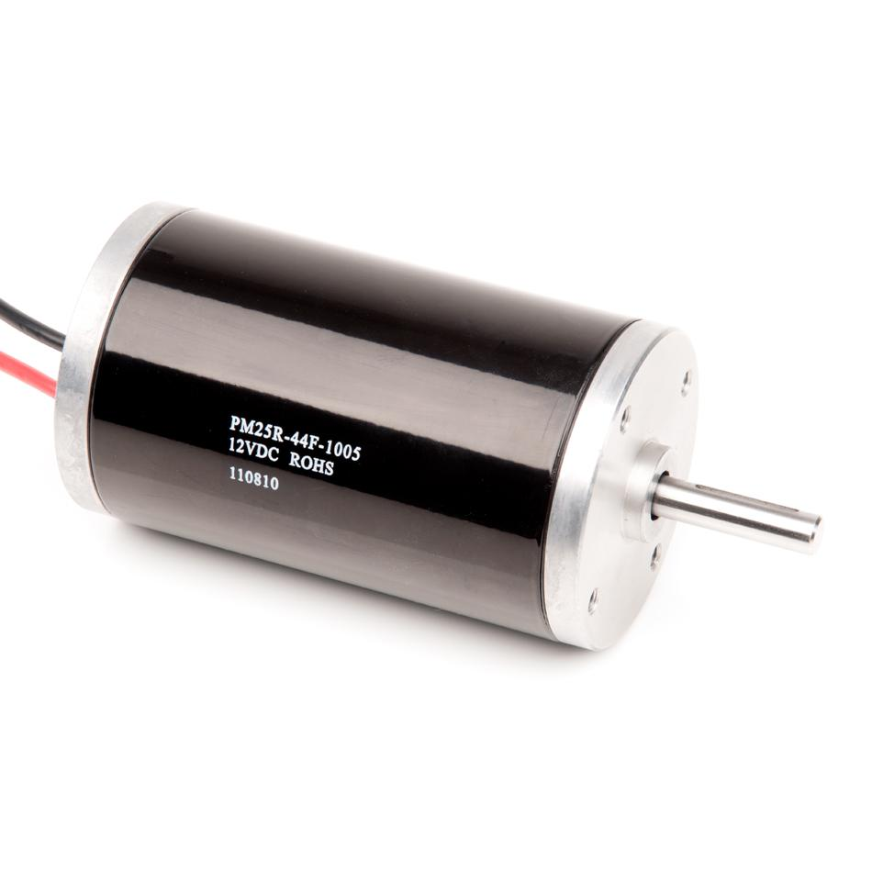
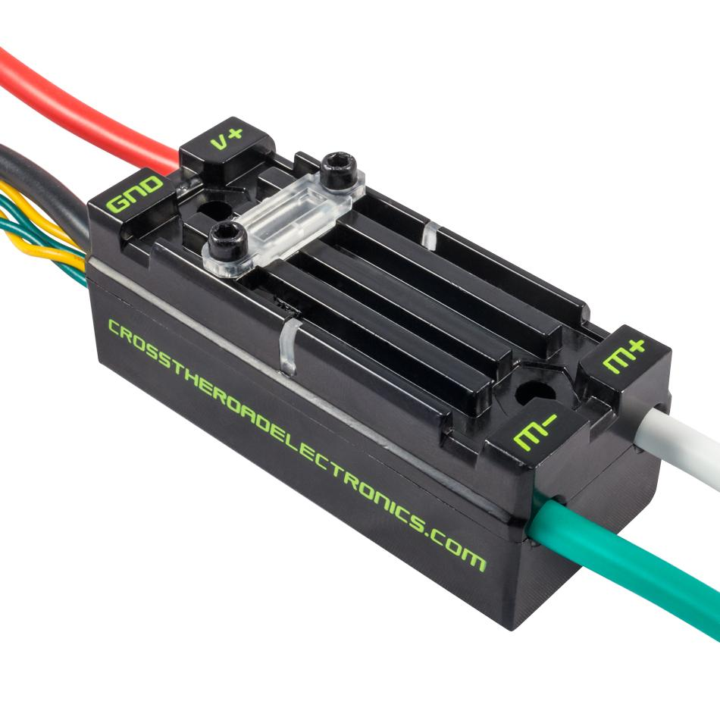
Talons & Speed Controllers
We can’t write code for the motors because they don’t have computing power. In order for us to control motors, then, we’ll need to use speed controllers. Speed controllers allow us to send varied feedback to motors, like “half speed forward” or “full reverse.” The type of speed controllers we use are Talons.
controls
Notes:
Mention that Talons can be set to any value from -1.0 (backwards full speed) to 1.0 (forwards full speed)

Slide 7
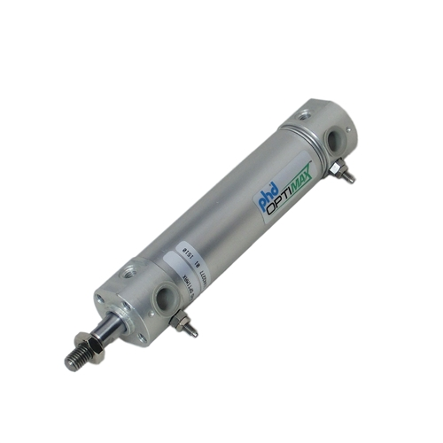
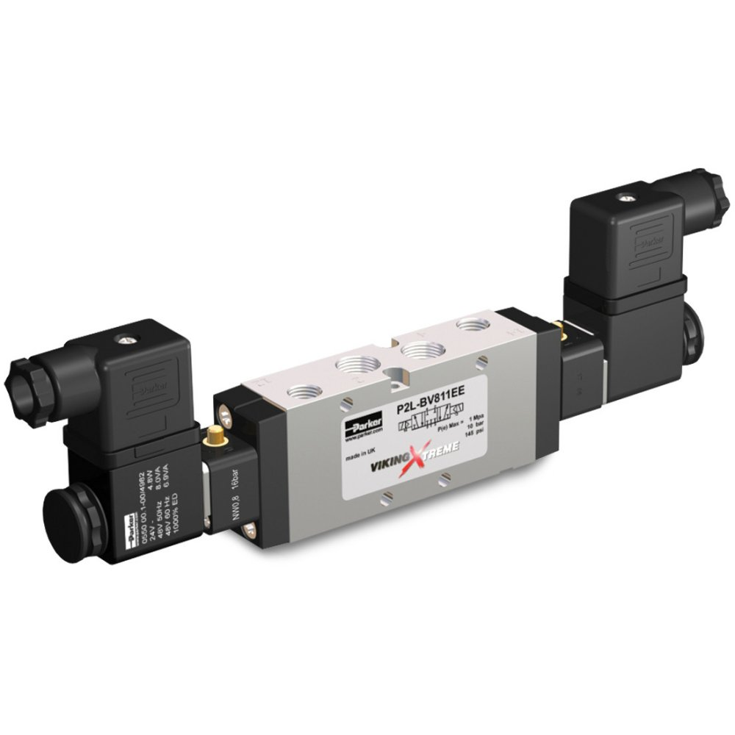
Solenoids
In the same way we need to use speed controllers to write code for motors, we need to use solenoids to control pistons. Pistons extend and retract based on electrical signals given by the solenoid.
controls

Slide 8

So how can we code for the different parts of the robot?

Slide 9

From Robot to Code
Now that we’ve gone over the important physical parts of the robot, how do we interact with them through code? To do this, we use something called an API. API stands for Application Programming Interface, and is basically a compilation of tools to build software. FIRST releases an API specifically for FRC, that has classes for each robot part, as well as the constructors and methods, so we can write code. The API from last year can be found here: http://first.wpi.edu/FRC/roborio/release/docs/java/ .
Let’s go over parts of the API to see how we can use it during build season.

Slide 10
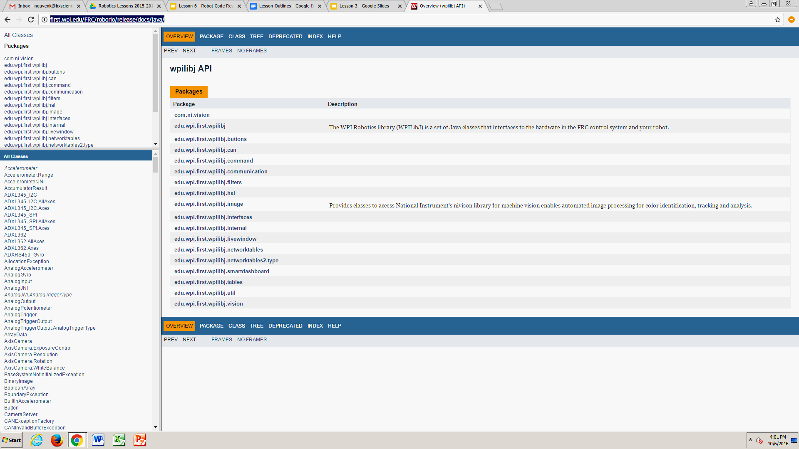
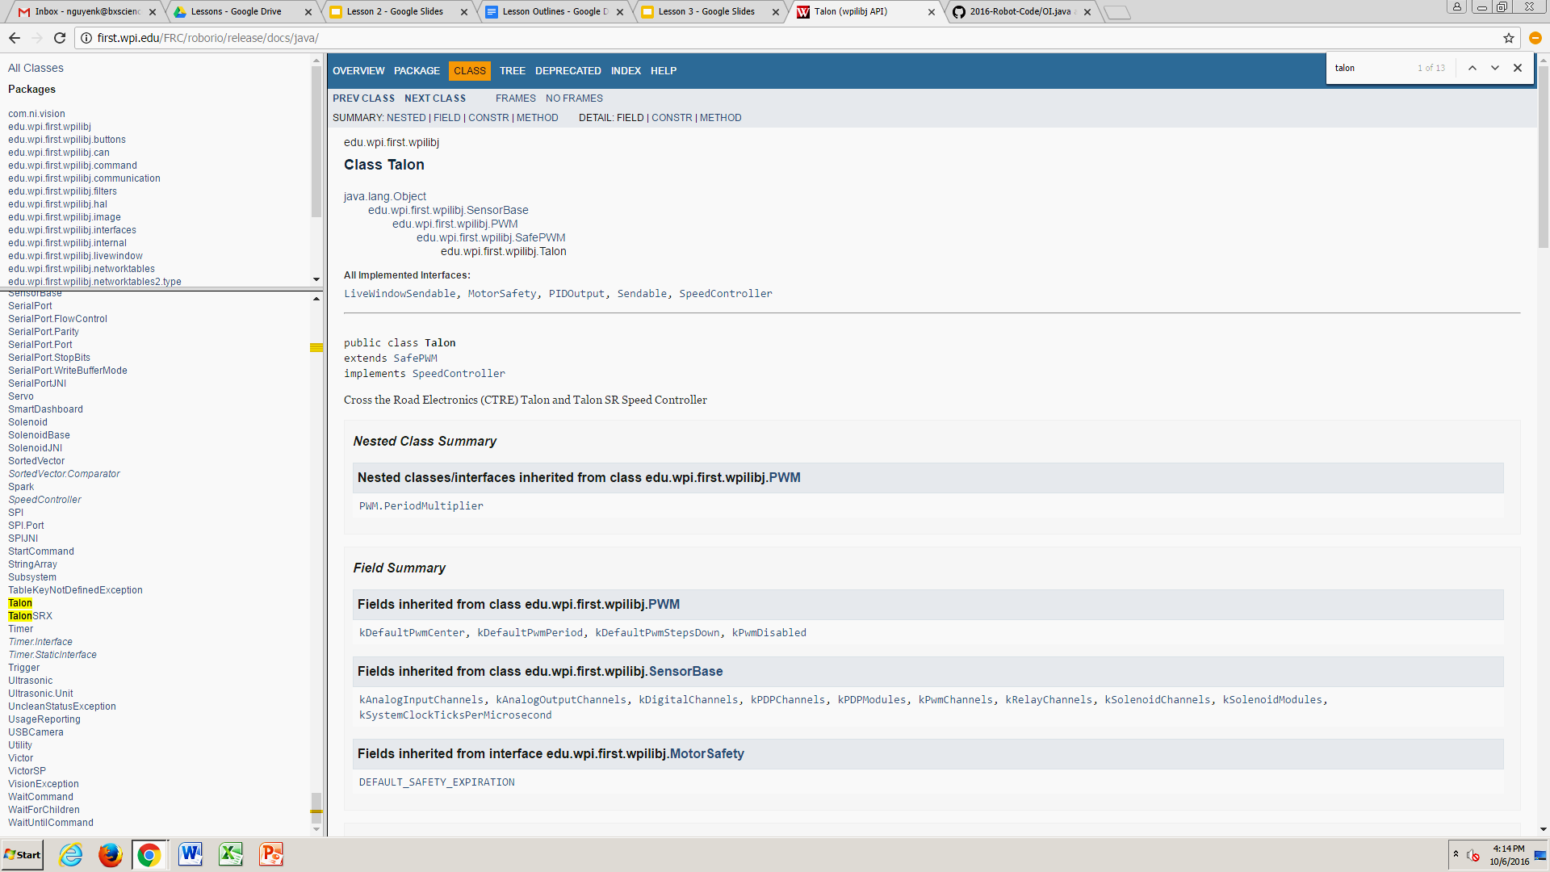
Classes from the API
If you look on the left side of the API, you’ll see a list of all the existing classes that FIRST provides us with. As you can see, it’s a lot. To use one (or multiple) of these classes, we need to import them into our code. For example, to import a joystick, we simply write: import edu.wpi.first.wpilibj.Joystick;
To find the exact thing we should import, all we need to do is go to the class we want to use, and under the class name, there will be a hierarchy of sorts. We will import the last one shown.
Notes:
Ask them to write the import statements for a joystick and a solenoid (5 min).

Slide 11

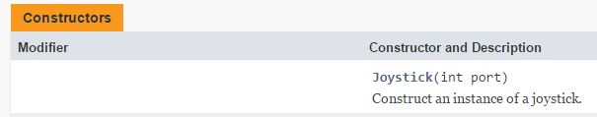
Making Instances of Classes
Last time, we learned about constructors and making instances of a class. The API provides constructors that we can use to make our objects. Let’s take a look at the Joystick constructor.
How would we create a new Joystick called atkJoy in port 3?
Notes:
Best answer: Joystick atkJoy = new Joystick(3);

Slide 12

Methods from the API
Now that we know how to import classes and make instances of them, we can look at the methods inside the classes! Let’s go to the Talon class on the API. Let’s focus on the set() method. What is the parameter that this method uses?
The speed that we set our talons to is on a scale from -1.0 to 1.0.
What would we set the speed to if we wanted the motor to go full speed backwards?
What about half speed forward?
Since we’re given these methods and parameters, using these in the robot code is simple!
Notes:
Parameter is “double speed”. Full speed backwards = -1.0, Half speed forward = -0.5

Slide 13

Real Robot Code (!)
This is code that makes the robot drive. Let’s break it down!
package org.usfirst.frc.team2265.robot.subsystems;
import edu.wpi.first.wpilibj.Joystick; import edu.wpi.first.wpilibj.RobotDrive; import edu.wpi.first.wpilibj.CANTalon;
public class Drivetrain {
public static CANTalon frontLeft= new CANTalon(RobotMap.frontLeftPort); public static CANTalon frontRight= new CANTalon(RobotMap.frontRightPort); public static CANTalon rearLeft= new CANTalon(RobotMap.rearLeftPort); public static CANTalon rearRight= new CANTalon(RobotMap.rearRightPort);
public static Joystick atkJoy = new Joystick(RobotMap.atkJoyPort);
public static RobotDrive TankDrive= new RobotDrive(frontLeft, rearLeft, frontRight, rearRight);
public void drive(){ double leftVal= atkJoy.getRawAxis(1); double rightVal=atkJoy.getRawAxis(5); TankDrive.tankDrive(leftVal, rightVal); }
}

Slide 14


Drive Code - Part 1
package org.usfirst.frc.team2265.robot.subsystems;
import edu.wpi.first.wpilibj.Joystick; import edu.wpi.first.wpilibj.RobotDrive; import edu.wpi.first.wpilibj.command.Subsystem; import edu.wpi.first.wpilibj.smartdashboard.SmartDashboard; import edu.wpi.first.wpilibj.CANTalon;
Here, we use imported classes from the API. Can someone find the API reference for one of these classes?

Slide 15
Drive Code - Part 2
public class Drivetrain {
public static CANTalon frontLeft= new CANTalon(RobotMap.frontLeftPort); public static CANTalon frontRight= new CANTalon(RobotMap.frontRightPort); public static CANTalon rearLeft= new CANTalon(RobotMap.rearLeftPort); public static CANTalon rearRight= new CANTalon(RobotMap.rearRightPort);
public static Joystick atkJoy = new Joystick(RobotMap.atkJoyPort);
public static RobotDrive TankDrive= new RobotDrive(frontLeft, rearLeft, frontRight, rearRight);
We create our class here, called Drivetrain. We also declare and instantiate the parts of the robot here, using API classes.
Notes:
Explain RobotMap

Slide 16
Drive Code - Part 3
public void drive(){ double leftVal= atkJoy.getRawAxis(1); double rightVal=atkJoy.getRawAxis(5); TankDrive.tankDrive(leftVal, rightVal); }
This is the actual method we use to drive the robot! We use some API methods here that make things really easy, like tankDrive. Can someone explain how the driver controls the robot using this code?(Hint: getRawAxis gets the position of the joysticks on the controller.)

Slide 17

More Real Robot Code
This is the code that makes a piston extend and retract.
package org.usfirst.frc.team2265.robot.subsystems;
import edu.wpi.first.wpilibj.DoubleSolenoid; import edu.wpi.first.wpilibj.DoubleSolenoid.Value;
public class Piston extends Subsystem { DoubleSolenoid actuator, actuator2; public Piston (int port1, int port2, int port3, int port4) { actuator = new DoubleSolenoid(port1, port2); actuator2 = new DoubleSolenoid(port3, port4); }
public void extend() { actuator.set(DoubleSolenoid.Value.kForward); actuator2.set(DoubleSolenoid.Value.kForward); } public void retract() { actuator.set(DoubleSolenoid.Value.kReverse); actuator2.set(DoubleSolenoid.Value.kReverse); }
}

Slide 18
Piston/Solenoid Code - Part 1
package org.usfirst.frc.team2265.robot.subsystems;
import edu.wpi.first.wpilibj.DoubleSolenoid; import edu.wpi.first.wpilibj.DoubleSolenoid.Value;
public class Piston extends Subsystem { DoubleSolenoid actuator; public Piston (int port1, int port2) { actuator = new DoubleSolenoid(port1, port2); }
This imports the Solenoids (they’re double because they can go in and out), and makes the constructor for a piston. Can someone construct a new Piston?

Slide 19
Piston/Solenoid Code - Part 2
public void extend() { actuator.set(DoubleSolenoid.Value.kForward); } public void retract() { actuator.set(DoubleSolenoid.Value.kReverse); }
These methods extend and retract the pistons. kForward and kReverse are the Values that correspond to position - think of it like True/False.

Slide 20
What’s next:
Our next meeting will be next Wednesday, October 18th, right here after 10th.
The things we learned today are going to be really important, but we know it was a lot to handle, so if you have any questions, email us!
>Zarrin: aliz@bxscience.edu
>Carol: shaot@bxscience.edu
See you guys later!

